Slide 1


Introduction to
Robotic Process Automation
Title of the Project
Your Register No: 220701294
Name:Suruthi S
Guide Name:Mrs.U.Farjana (M.Tech)
Designation and Department:Assisstant Professor/CSE

Slide 2
Abstract
The Smart Borrower Automation System is a comprehensive solution designed to streamline borrowing and return processes for resource management. Utilizing key data columns—ID, Borrower's Name, Profession, BookID, Book Name, Issued On, Returned Date, and Fine Charges—the system automates tasks like transaction recording, fine calculation, and notification dispatch. Borrower and book details are validated and auto-populated from a central database, ensuring data consistency. Issuance and return dates are logged automatically, with fines calculated based on overdue returns. Personalized rules, such as profession-based borrowing policies, enhance flexibility. Integrated notifications remind borrowers of due dates, overdue returns, and fines, improving compliance. The system also provides analytical insights through automated reporting. This RPA-powered solution reduces manual effort, minimizes errors, and enhances the overall efficiency of resource lending operations, making it ideal for libraries, academic institutions, or any asset-lending framework.

Slide 3
Need for the Proposed System
In traditional borrower management systems, the process of issuing and returning resources, such as books or equipment, is largely manual and prone to inefficiencies.
Borrower details, including names, professions, and resource information like IDs and issue dates, are often recorded manually or using basic software, which lacks automation. Fine calculations for overdue returns are typically done manually, leading to potential errors and inconsistencies.
Notifications for due dates or overdue fines rely on manual communication or are entirely absent, resulting in delayed returns and resource mismanagement. Additionally, the absence of a centralized database makes data retrieval and validation cumbersome, increasing the risk of redundant entries or missing records.
Overall, the existing system is time-consuming, error-prone, and inefficient, with limited capabilities for tracking, reporting, or managing borrowing activities effectively. This calls for an automated solution like the Smart Borrower System to overcome these limitations and improve the resource management process.

Slide 4
Advantages of the Proposed System
The Smart Borrower System is an automated solution designed to address the inefficiencies of traditional borrowing management systems.
It streamlines the process by automating borrower registration, resource issuance, return tracking, and fine calculations.
The system integrates a centralized database to ensure data consistency and eliminates redundant entries.
Automated notifications remind borrowers of due dates and overdue returns, reducing delays and improving compliance.
Real-time fine computation and reporting capabilities provide transparency and accountability.
Additionally, the system offers analytical insights into borrowing patterns, enabling better resource utilization. By leveraging automation, the Smart Borrower System minimizes manual effort, reduces errors, and enhances the overall efficiency and user experience of resource-lending operations

Slide 5
Implementation
Open UiPath Studio and check the version of the application. While it’s not mandatory to use the latest version, it is recommended as updates may include new features or improvements to existing Packages/Activities/Properties that could enhance the project.
Once the application is opened, create a new process, name the file appropriately (e.g., Smart Borrower Automation Bot), and choose the directory where the UiPath files will be stored.
After completing these steps, you will be ready to proceed with building the workflows for automating lending institution resource management and penalty reconciliation.

Slide 6
Project workflow
Input Dialog – To capture user inputs such as user ID or return dates.
Invoke Workflow – To call reusable workflows for specific tasks like fine calculation or report generation.
Try Catch – To handle errors and ensure smooth execution of the bot.
Read Range – To read lending institution records from Excel files or databases.
Write Range – To update or organize reconciled data into structured Excel files.
Send SMTP Mail Messages – To send penalty notifications and summary reports via email.
Log Message – To log the execution details and track the bot’s performance.
Filter Data Table – To apply rules for fine calculation and customize the reconciliation process.
Message Box – To provide real-time updates or prompts for user interaction.

Slide 7
Explaining the Sequence
1. User Input Collection:
The bot prompts the administrator to input essential information such as user ID, book return dates, or penalty rules using an Input Dialog activity.
This ensures the bot has the necessary parameters to reconcile loan repayments or interest calculations accurately.
2. Read Borrowing Records:
Using Read Range or other Excel activities, the bot retrieves borrowing and return data from the lending institution database or spreadsheet.
This data serves as the foundation for penalty calculation and reconciliation.
3. Penalty Calculation and Reconciliation:
The bot processes the borrowed book details and calculates overdue loan repayments or interest calculations based on predefined rules.
Customizable options allow for partial waivers or adjustments during the reconciliation process.

Slide 8
1. Organize and Store Data in Excel:
The reconciled data is formatted and structured using Write Range and Filter Data Table activities.
This creates a clear and comprehensive record of loan repayments or interest calculations and borrowing updates, stored in an Excel file.
2. Send Email with Reconciled Data:
The bot uses the Send SMTP Mail Message activity (or another email service) to attach the Excel file and email it to users or administrators.
A confirmation message may also be displayed to notify that the email has been sent successfully.
6.Error Handling and Logging:
Throughout the workflow, the bot employs Log Message activities to record each step and any errors encountered. Try Catch and Retry Scope mechanisms handle potential failures in critical parts such as data processing or email delivery.
7.Display Success Notification:
Once the entire process is completed, a final Message Box or notification confirms successful reconciliation and email delivery.

Slide 9
PACKAGES REQUIRED
For the successful completion of the Smart Borrower Automation Bot, it is crucial to download the necessary packages to enable the required activities. The following packages should be installed:
UiPath.Excel.Activities: To manage Excel files for organizing borrowing records and penalty details.
UiPath.Mail.Activities: For sending penalty reports and notifications via email to users and administrators.
UiPath.WebAPI.Activities: For integrating external APIs, if needed, to enhance lending institution management workflows.
UiPath.UIAutomation.Activities: For interacting with lending institution management systems, extracting user and book details.
UiPath.System.Activities: For performing essential workflow automation tasks like logging, decision-making, and exception handling

Slide 10
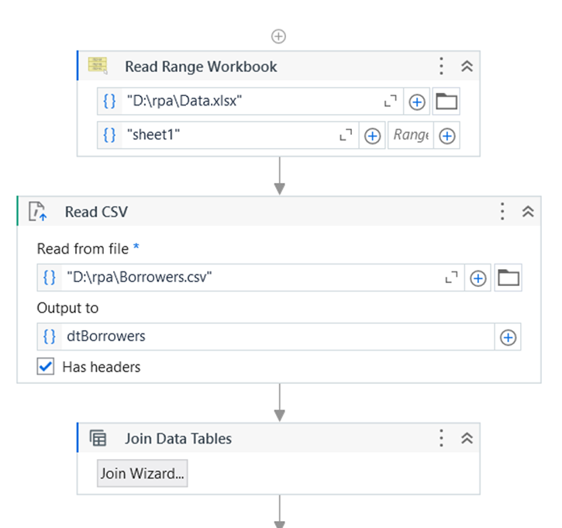
Implementation Screenshot

Slide 11
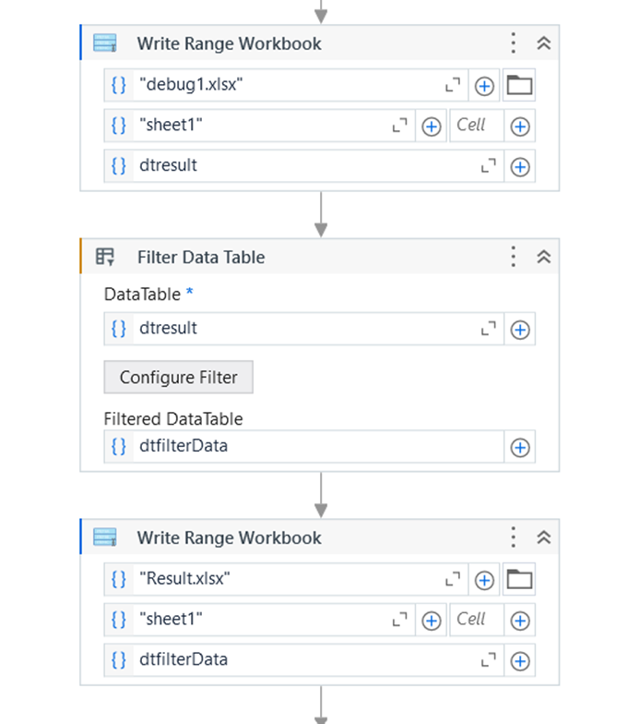

Slide 12
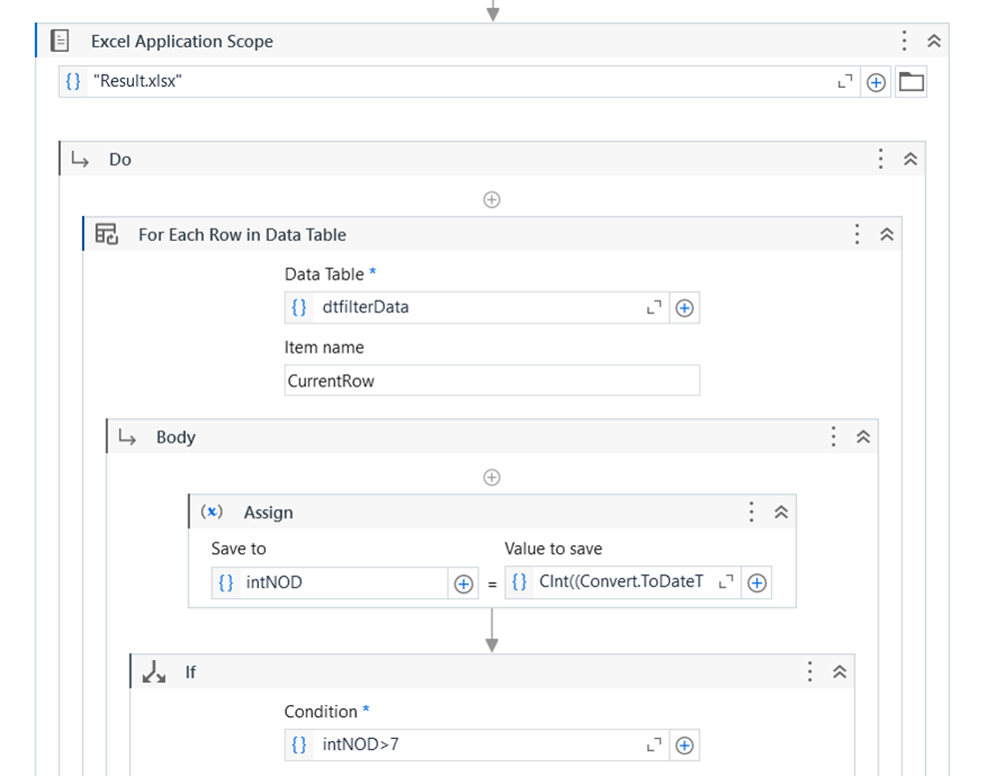

Slide 13
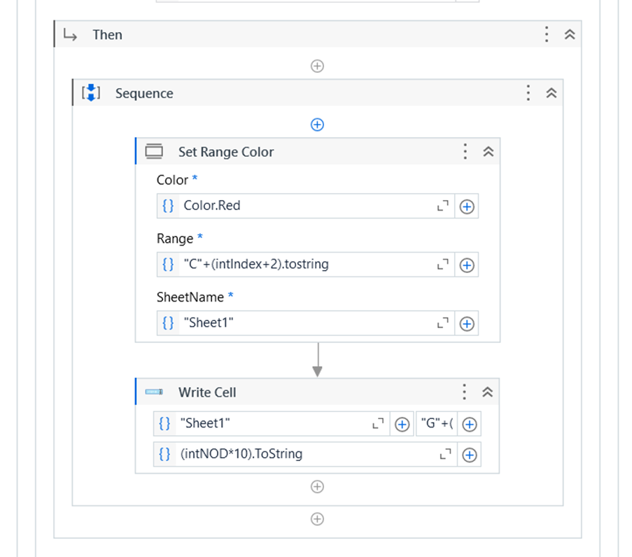

Slide 14
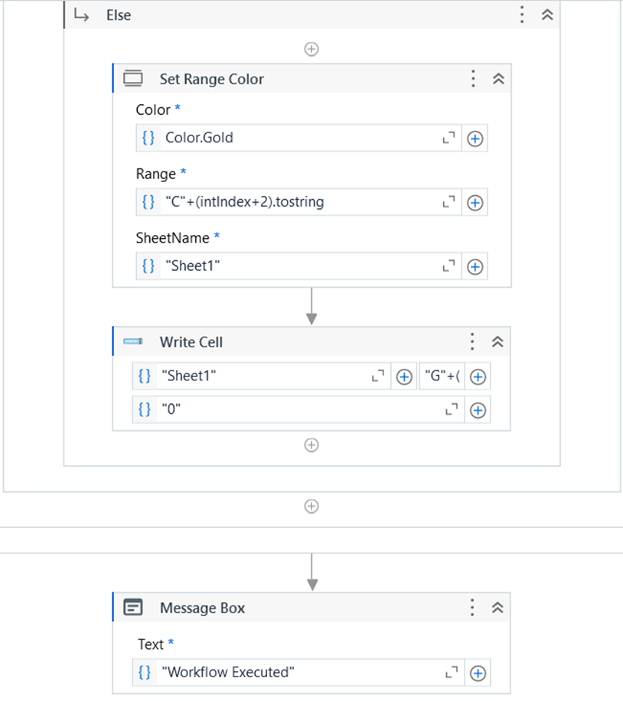

Slide 15
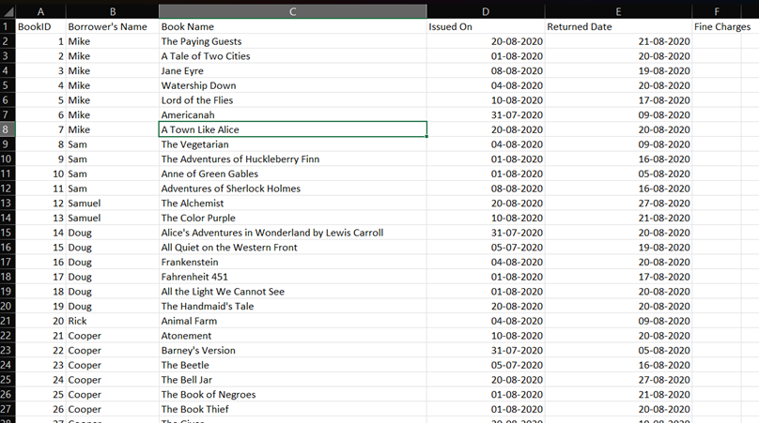
Testing
Library Data File (Input)

Slide 16
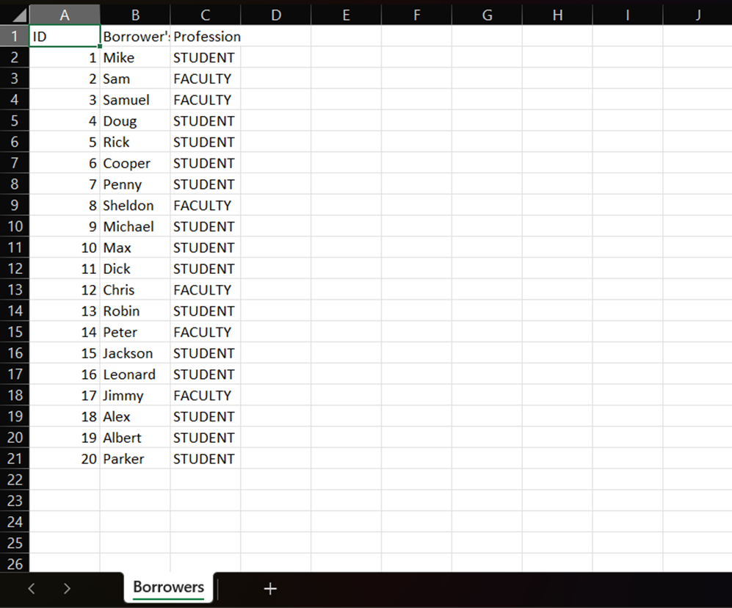
Borrowing Records (Input)

Slide 17
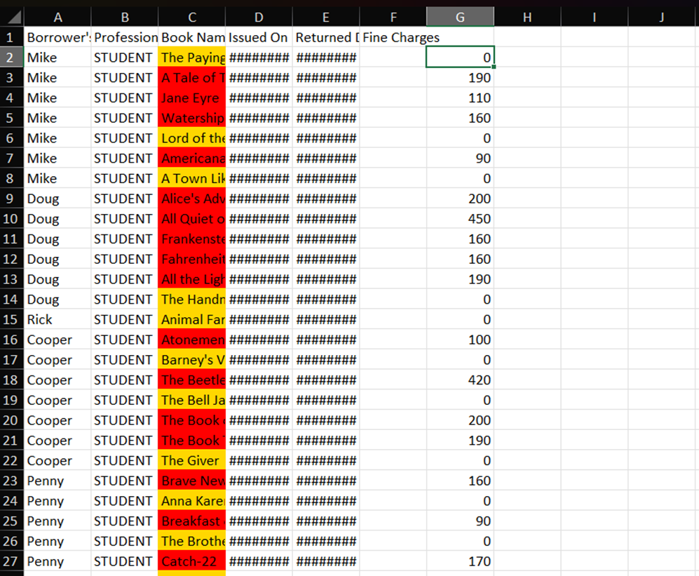

Slide 18
Conclusions
The Smart Borrower Automation Bot streamlines the process of managing lending institution resources, reconciling loan repayments or interest calculations, and notifying users. By leveraging UiPath RPA tools, the bot automates the retrieval of borrowing records, calculates loan repayments or interest calculations, organizes data into Excel files, and sends notifications via email. This reduces manual effort, saves time, and ensures accurate record management, enhancing the efficiency of lending institution operations.
The bot also incorporates robust error-handling and retry mechanisms, ensuring reliability even in case of data inconsistencies or process interruptions. By providing structured reports in Excel, it allows administrators to easily review and manage records, ensuring accurate and fair penalty reconciliation.
In conclusion, the Smart Borrower Automation Bot demonstrates the power of RPA to automate repetitive tasks, improve workflow efficiency, and enhance user experience. It offers a scalable and user-friendly solution for libraries, simplifying resource management and ensuring accurate and timely data processing.

Slide 19
References
UiPath Forum: The UiPath Forum community where users share their experiences and solutions. https://forum.uipath.com/
UiPath Documentation: The official documentation of UiPath features and functionalities https://docs.uipath.com/

Slide 20
Thank You

